Slide 1






Technex ‘22
Robotics Conclave
Team : Meca - Doodle
Project : VOCMEF ( Voice Controlled Mecanum based Forklift )
Team Members :
Ayush Agarwal (Inventor)
Shivansh Dubey
Manali Pawar

Slide 2

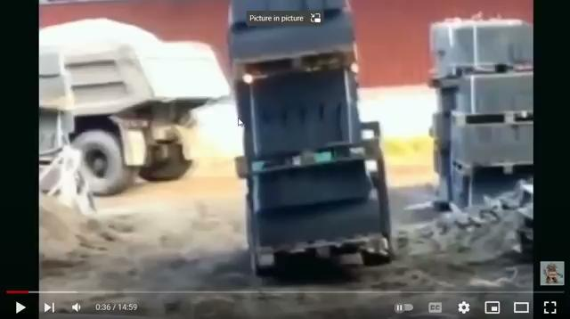
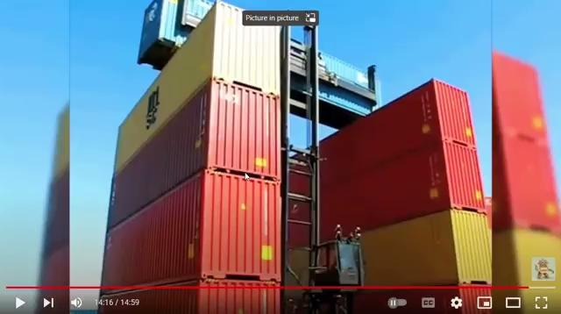
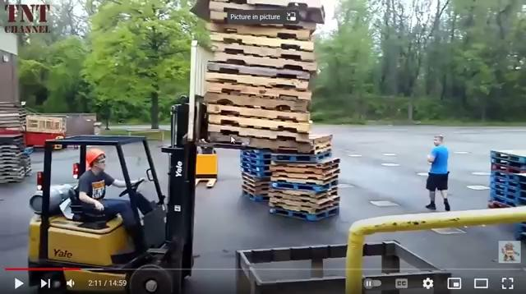

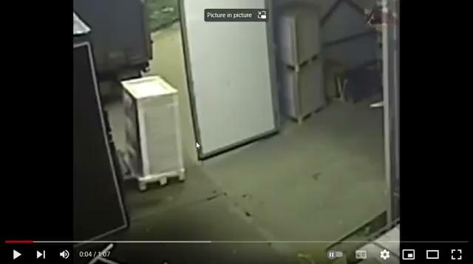
Problem Statement :
Presently available forklift in industry and their drawbacks :
Forklift Toppling
Sideways toppling
Frontways toppling
Human injury
Industrial wastage and damage to goods

Slide 3
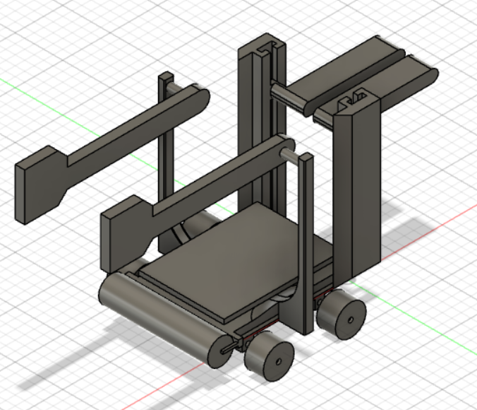
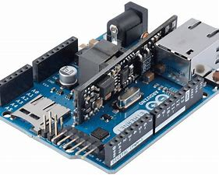

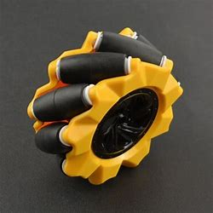
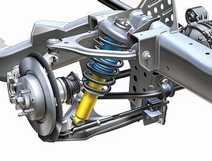
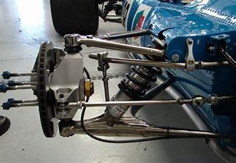
Solution :
The VOCMEF
(aka Voice controlled mecanum based forklift )

Slide 4
How VOCMEF tackles problems :
Avoids sideways toppling of the goods as there are side rods to avoid the sideways falling of the goods .
Avoids front toppling of the goods , as the goods are bought to the center of the forklift using the belt drive .
A great model for lifting boxes , as well as collection of small objects thus suiting multiple needs .
Can carry more goods at a time as there is no human sitting on it hence space is saved .
Reduces the risk of human injury as the human can operate the machine from a distance .
Reduces cases of forklift toppling as the goods are kept at the center of the forklift .
Allows even factory workers to do WFH , assuming they are given the live footage of surveillance videos of the factory/warehouse .
Mecanum wheels allow it to take more sharper and smoother turns , thus easing its motion in factory warehouses .
Double WishBone Suspension helps increase the stability even more .
In short , an ultimate boon to the industry .

Slide 5
Mechatronic model of the project
Processing in microprocessor : Speech Recognition Deep Learning Model
Signal Processing : Output number converted to hamming code
Signal : Voice
Sensor : Phone/
Laptop microphone
THE VOCMEF
Communication :
Bluetooth
Actuators : Motors in the VOCMEF
Signal Processing : Hamming code decoding
Microprocessor : Arduino

Slide 6
ML Model for Speech recognition :
Dataset : Our dataset consists of 8000 audio files in .wav format, equally distributed in 8 different commands we need. Each file is 1 second or short in length.
Reading audio files : The .wav audio file is decoded into binary format through tensorflow library’s function.
Short Time Fourier Transform : STFT is done over the decoded audio file, which outputs a spectrogram for the audio fed into it, which is a 3-dimensional plot between time, frequency and amplitude of audio signal.
CNN : Using images of spectrograms of audio files in the dataset, we create a neural network which is trained and tested with the help of the available dataset. Further our task transforms into image processing. Further, the model is optimized by Adam optimizer.
This CNN was able to fetch out 83-86% of accuracy in our runs.
Prediction : When audio is given to the model, it gives the array index as the output which is mapped to the commands. This index is fed to the driver program which takes over the further control.

Slide 7
Traditionally, a statistical model called Hidden Markov Model was used in the industry for speech recognition purposes. But with the rise of Deep Learning and the ease and accuracy of neural networks, the industry now uses hybrid model of Hidden Markov Model and CNNs. Through CNNs, we are able to get decent accuracy in results, along with more compatible hardware and easy implementation.

Slide 8
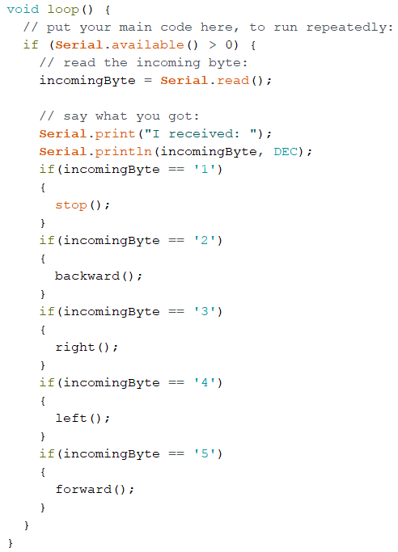
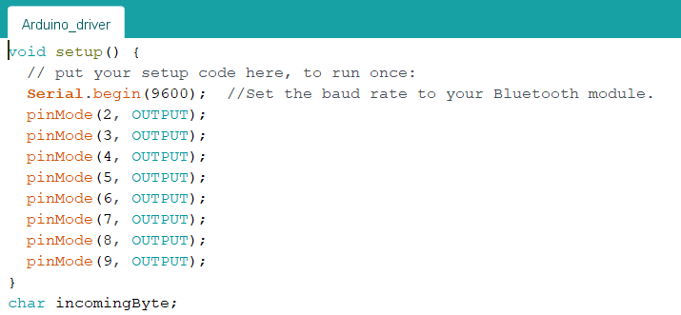
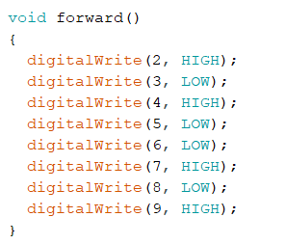
Arduino Part of project :
1) Initialized the serial
monitor and output pins
2) Logic High and Low is given to pins, according to the motion needed. This is kept compatible to the L293D motor driver used.
3) The loop function continuously reads output from serial port and accordingly executes the if-else commands mapped to the received byte.

Slide 9
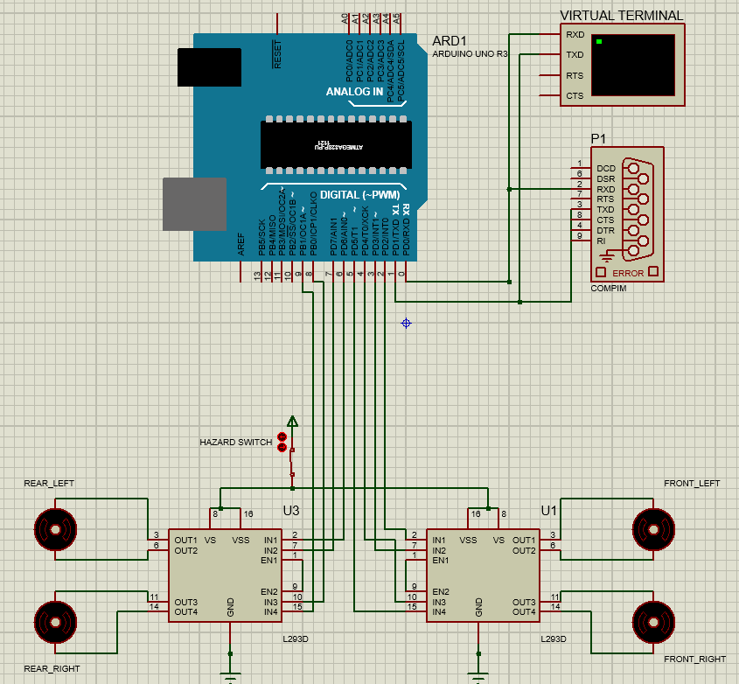
Proteus Part of project :
Components used-
Arduino Uno
The brain
COMPIM
for communicating between COM ports
Virtual Terminal
L293
Motor Driver
Motors
Hazard Switch
To shut the system in case of any emergency

Slide 10
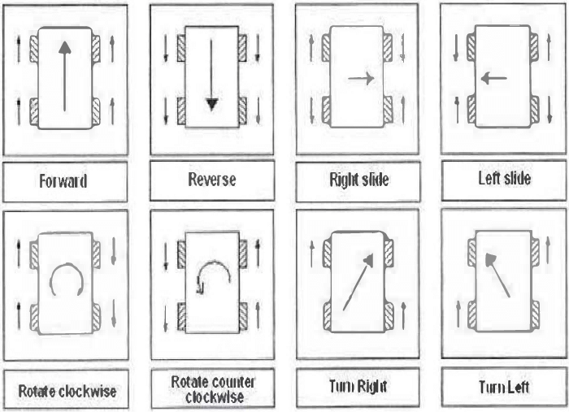
Mecanum part of project :
A simple logical approach to achieve 2-D motion of any vehicle using different rotations of the four wheels.

Slide 11
The Hamming code :
The model built so far can be taken a step ahead by integrating a hamming code with it. Hamming code is a self correcting code which detects and removes any single bit error, which can by chance arise while communicating. The process of communication is through bluetooth COM ports, where such situation may occur in case of interference from surroundings. Hence, hamming code will ensure precise transmission of digital data.

Slide 12
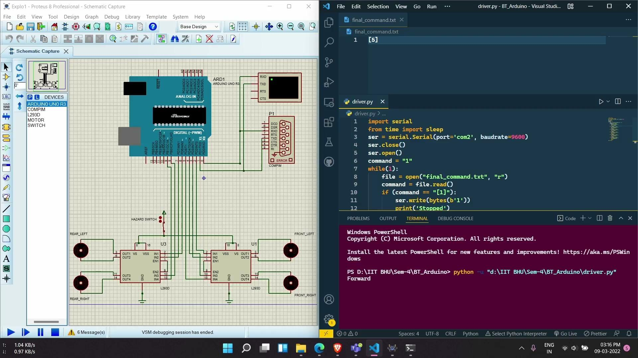
Simulation

Slide 13
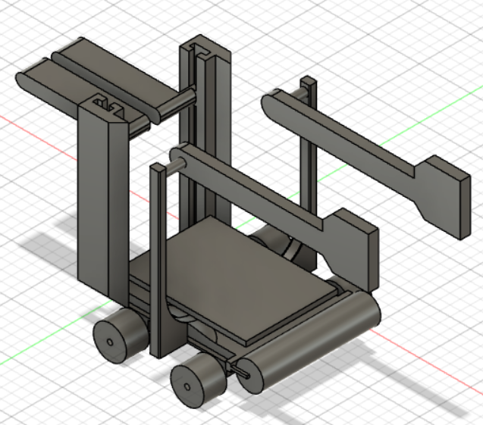
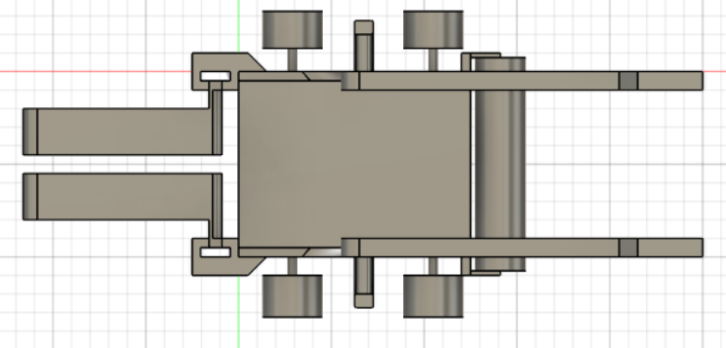
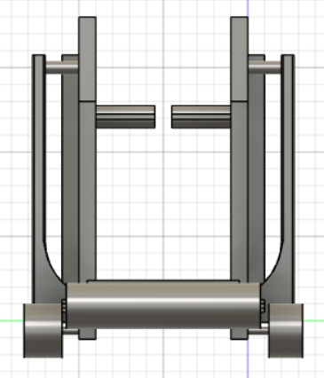
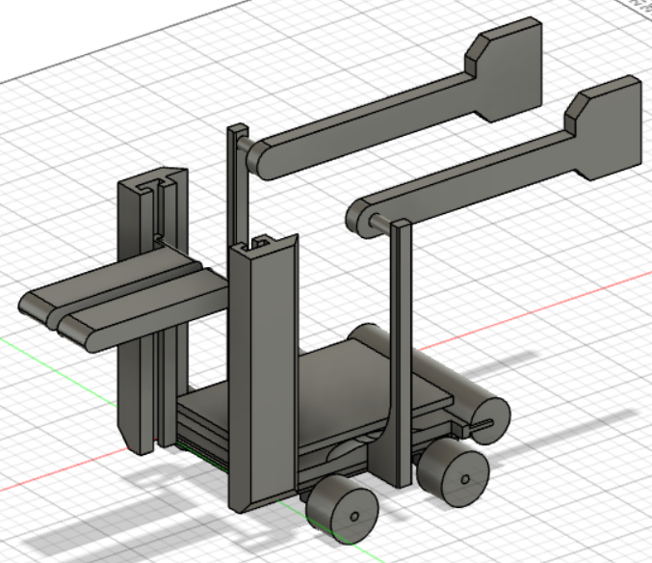
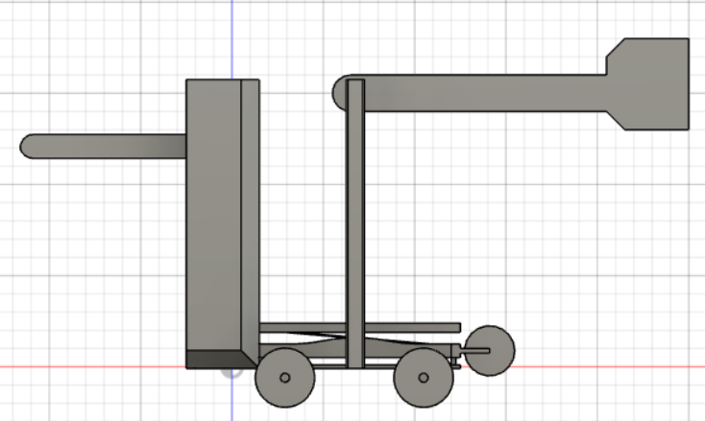
CAD Model pictures :

Slide 14

Thank You

